Slide 1

Robot Abstraction

Slide 2
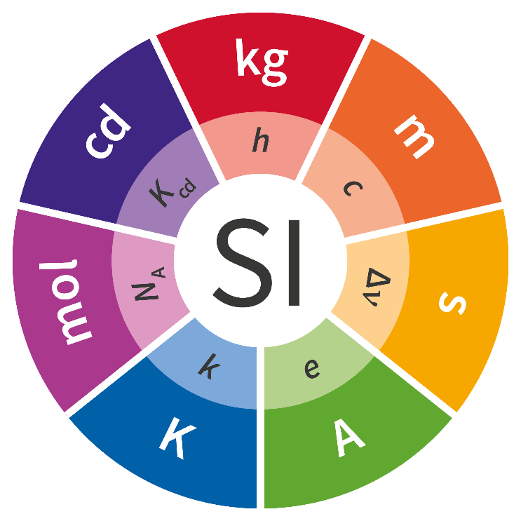

What is?
Machines can really only see in numbers so that mechanism has to be abstracted to a number. This number has to always relate to the SI units in some way. This to make sure that if something changes in the mechanism, the code can be adapted quickly and without much trouble.
X amount of m/s.

Slide 3
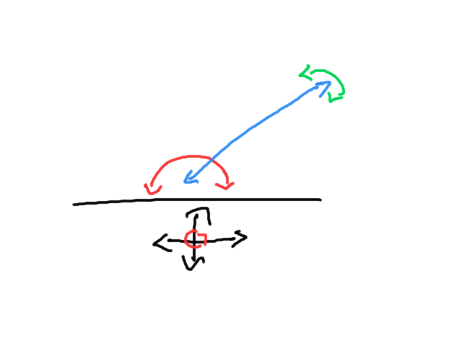
Abstraction in mechanism
What is the simplest way that you can image a robot to be, that is the way to go. All mechanism have a unit to represent them, that could be a position units a velocity units n acceleration unit a heat unit alight units, etc.
The chassis move at x or y m/s or rotate at x rads/s
The telescope can be at x meters.
And the arc can be at x radians.
They all have a number to represent them.

Slide 4
In code they are all just numbers
There is no other way to put it, in code they are represented by a bunch on numbers.

